Slide 1
Recursion

Slide 2
Recursion
A function calling itself, directly or indirectly, is called a recursive function.
The phenomenon itself is called recursion.
Example:
0! = 1
n! = n * (n-1) * (n-2)!
Even(n) = (n==0) || Odd(n-1)
Odd(n) = (n!=0) && Even(n-1)

Slide 3
Properties
The arguments change between the recursive calls.
5! = 5 * 4! = 5 * 4 * 3! = ...
Change is towards a case for which solution is known (base case)
There must be one or more base cases
0! = 1
or
Odd(0) is false
Even(0) is true

Slide 4
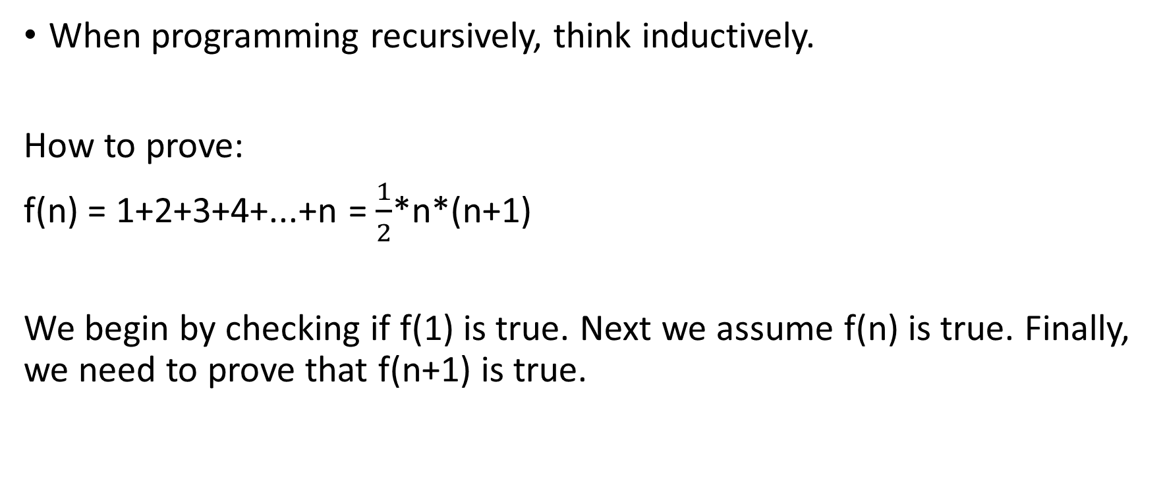
Recursion and Induction
When programming recursively, think inductively.
How to prove:
f(n) = 1+2+3+4+...+n = $\frac{1}{2}$*n*(n+1)
We begin by checking if f(1) is true. Next we assume f(n) is true. Finally, we need to prove that f(n+1) is true.

Slide 5
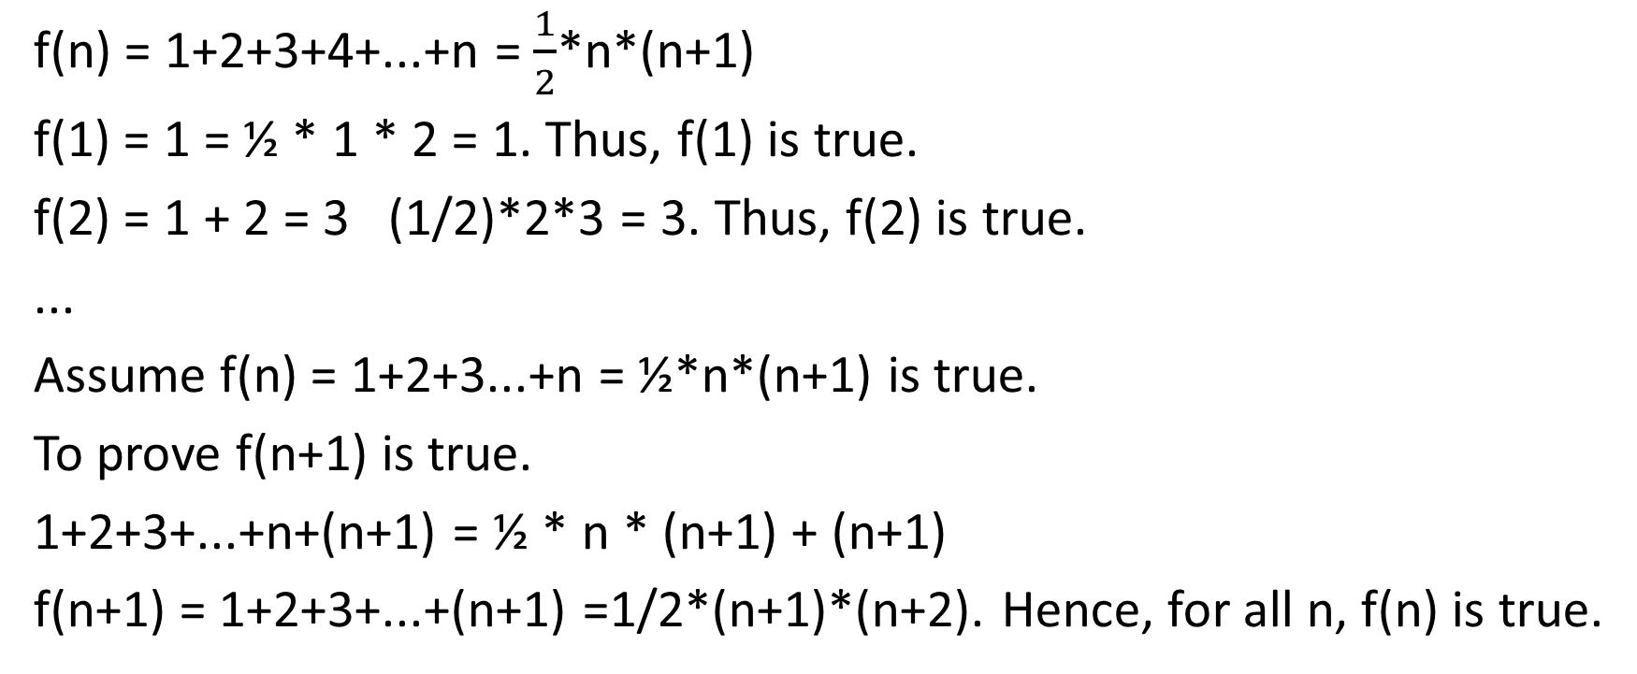
Proof
f(n) = 1+2+3+4+...+n = $\frac{1}{2}$*n*(n+1)
f(1) = 1 = ½ * 1 * 2 = 1. Thus, f(1) is true.
f(2) = 1 + 2 = 3 (1/2)*2*3 = 3. Thus, f(2) is true.
...
Assume f(n) = 1+2+3...+n = ½*n*(n+1) is true.
To prove f(n+1) is true.
1+2+3+...+n+(n+1) = ½ * n * (n+1) + (n+1)
f(n+1) = 1+2+3+...+(n+1) =1/2*(n+1)*(n+2). Hence, for all n, f(n) is true.

Slide 6
Main
fact(5) 5 * fact(4)
fact(4)
4 * fact(3)
fact(3)
3 * fact(2)
fact(2)
2 * fact(1)
fact(1)
1 * fact(0)
fact(0)
return 1;

Slide 7
Example
Write a function search(int a[], int n, int key) that performs a sequential search of the array a[0..n-1] of int. Return 1 if the key is found, otherwise returns 0.
The think about the solution, think about searching an element in a smaller array. Don’t think in terms of loop...think in terms of recursion.

Slide 8
Solution
Base case: If there are no elements, you can return 0.
Otherwise:
compare last item, a[n-1] with key.
if a[n-1] == key, return 1
else search key in the remaining array of size n-1 and return the result of this “smaller” problem.

Slide 9
A
31
4
10
35
59
31
3
25
search(A, 8, 10)
Either A[7] == 10 or search(A, 7, 10)
80 it does not exist

Slide 10
Program
#include<stdio.h>
int search(int a[], int nEle, int key) {
if(nEle == 0) return -1;
if(a[nEle-1] == key) return 1;
return search(a, n-1, key);
}
void main() {
int arr[] = {1, 2, 3, 4, 5, 6, 7, 8, 9};
int key;
printf(“\nEnter a key to search:”);
scanf(“%d”, &key);
int pos = search(arr, 9, key);
if(pos)
printf(“Element found at position: %d”, pos + 1);
else
printf(“Element not found.“);
}

Slide 11
Recursion: Time Analysis
Let us try to compute the time taken by the function “search”.
Let us assume T(n) be the time it takes to search an element “key” in an array of size “n.”
Assume that if condition takes 1 time unit to execute.
Thus, T(n) = 1 + 1 + T(n-1)
or, T(n) = T(n-1) + C
The last statement is known as recurrence relation.

Slide 12
Solution to Recurrence Relation
We know the following:
T(n) = T(n-1) + C, T(0) = C
T(n-1) = T(n-2) + C
T(n-2) = T(n-3) + C
...
T(2) = 2C + C =3C
T(1) = 2C
Adding all, you get
T(n) = C + nC => T(n) is proportional to n

Slide 13
Binary Search
Can we search faster than “n” (linear search), where “n” is number of elements?
Yes, if the elements are sorted in ascending or descending order.
Ex: 1 2 3 4 5 6 7 8 9
Ex: 9 8 7 6 5 4 3 2 1
To search: 7

Slide 14
How it works?
Elements 1 2 3 4 5 6 7 8 9
Index 0 1 2 3 4 5 6 7 8
To search: 7
Left = 0, Right = 8, Value at pos 4 != 7. Also, Value at pMid = (0+8)/2 = 4
os 4 < 7. Thus, Left = Mid + 1
Left = 5, Right = 8, Mid = (5+8)/2 = 6
Value at pos 6 == 7, Thus, element is found.

Slide 15
Methodology
Ex: 1 2 3 4 5 6 7 8 9
To search: 7
Let us consider 3 variables: left, right, and middle.
Initially, left = 0 (position in array), right= length.
Calculate mid as (left+right)/2 and check if the key to be searched is found or greater or smaller.
If the key is greater than mid, you need to search in right array. Else, you need to search in the left array.

Slide 16
Function
int binarysearch(int a[], int start, int end, int key) {
if(start > end)
return -1;
int mid = (start + end)/2;
if(a[mid] == key)
return mid;
else if(a[mid] > key)
return binarysearch(a, start, mid – 1, key);
else
return binarysearch(a, mid + 1, end, key);
}

Slide 17
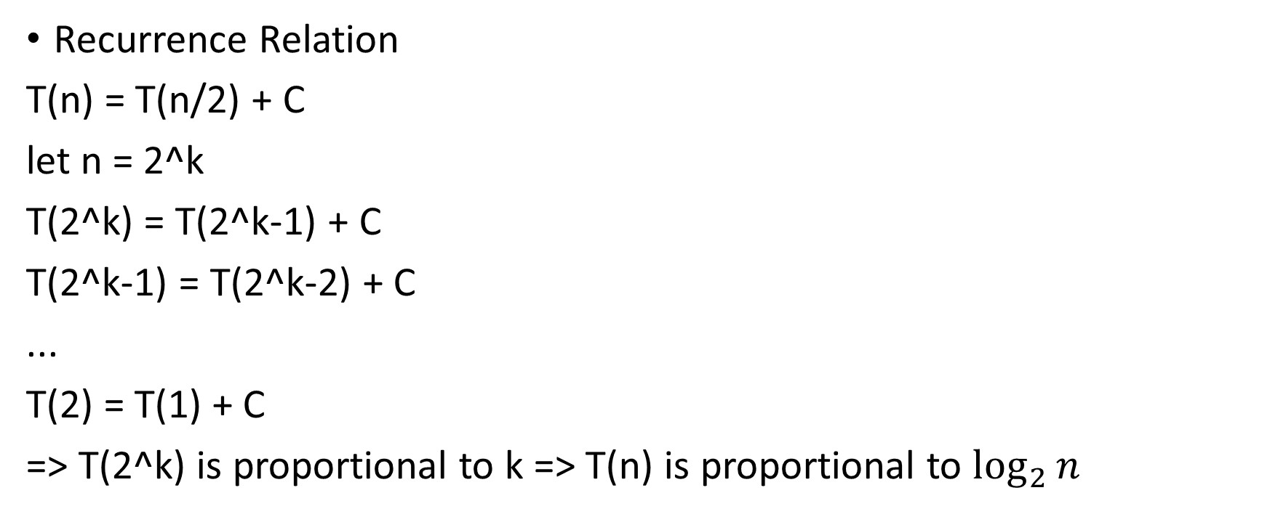
Time Taken?
Recurrence Relation
T(n) = T(n/2) + C
let n = 2^k
T(2^k) = T(2^k-1) + C
T(2^k-1) = T(2^k-2) + C
...
T(2) = T(1) + C
=> T(2^k) is proportional to k => T(n) is proportional to $\log_{2}{n}$

Slide 18

Fibonacci Numbers
Sequence like following
0 1 1 2 3 5 8 13
In general
$$F_{n}= F_{n−1}+ F_{n−2}$$

Slide 19
Code
int fibo(int term) {
if(term <= 1)
return term;
return fibo(term - 1) + fibo(term - 2);
}

Slide 20
Calculation

Slide 21
Tower of Hanoi
Move all discs from peg A to peg B using peg C.

Slide 22
Rules
Only one disk can be moved at a time
No disk may be placed on top of a smaller disk
How to think about it recursively?
Lets say if you have the following situation, then you need to move disk from peg A to peg B, then you need to move remaining disk from peg C to B.

Slide 23
Solution
So, if you have a function to move n disks from peg X to peg Y using peg Z, you can use it again to solve the situation.

Slide 24
Code
void Hanoi(int n, char A, char B, char C) {
if(n==0) return;
Hanoi(n-1, A, C, B);
printf(“Move 1 disk from %c to %c”, A, B);
Hanoi(n-1, C, B, A);
}

Slide 25
Summary
Advantage
Elegant Solution
Fewer Variables
Easy to implement once you figure out the recursive definition.
Disadvantage
Debugging is difficult
Figuring out the logic is sometimes difficult
Can be inefficient

